Slide 1

CEIR CEIR Admin -Training Manual

Slide 2

Agenda
Overview
UI Walk Thru
Consignment
Stock
Manage Type Approval
Block / Unblock
Stolen / Recovery
Grievance
Registration Request
Register Device
Pending TAC list
Search IMEI

Slide 3

Overview
CEIR Admin approve/reject all the the user related requests in the CEIR system.
Typical flow is as follows:
CEIR Admin
User Flow Management
Stakeholder login into the portal
Stakeholder submit a request on CEIR portal like register consignment, stock upload
CEIR Admin approve/reject request
Delete, Approve, Reject
CEIR System

Slide 4
Feature Impact / Use Cases
Importance of this feature for the CEIR System
This feature is one of the key feature in the system.
This allow CEIR admin to approve/reject the request in the CEIR system.

Slide 5
Configuration - Items
Item | Description
Consignment | Approve/Reject the consignment. Can also withdraw the consignment
Stock Management | Approve/Reject the stock. Can also withdraw the stock
Registration Request | Approve/Reject the self registration request as sent by user using Registration Portal. Can also change user state if required
Block/Unblock Device | Approve/Reject the block/unblock request from the mobile operators.
Stolen/Recovery | Approve/Reject the stolen/recovery request from the lawful agency.

Slide 6
Configuration – Items – Contd …
Item | Description
Grievance | Option to view and reply to raised grievance. Admin can also close the grievances
Manage Type Approval | Approve / Reject the Type approved request
Register Device | Approve/Reject the register device raised by end user/custom/immigration user
Pending TAC list | View/Delete the new TACs which are uploaded in the system as part of upload consignment
Update VISA | Approve/Reject the update Visa request raised by end user

Slide 7
CEIR Admin User – System Interface

Slide 8
Consignment
Once consignment is registered by importer and processed by the system successfully, it is approved/rejected by CEIR Admin
If approved by CEIR Admin, the consignment goes to custom for clearance
If rejected by CEIR Admin, then the consignment goes back to importer for updation and resubmission
Email Notifications is sent to the importer on approval/rejection by CEIR Admin
Filter can be set on Start Date/End Date, Transaction ID, Name, Consignment Status, Tax Paid Status, IMEI quantity, Device quantity
Clear All Filters can be used to clear filters and refresh the data table.
All consignment details can be exported if required based on filtered value or otherwise.
By default, the data displayed is sorted in descending order on last modified date.
Data can be sorted based on other fields by clicking the arrow buttons on the column headers. On first click, data will be sorted in ascending order. On second click, it will be sorted in descending order.

Slide 9
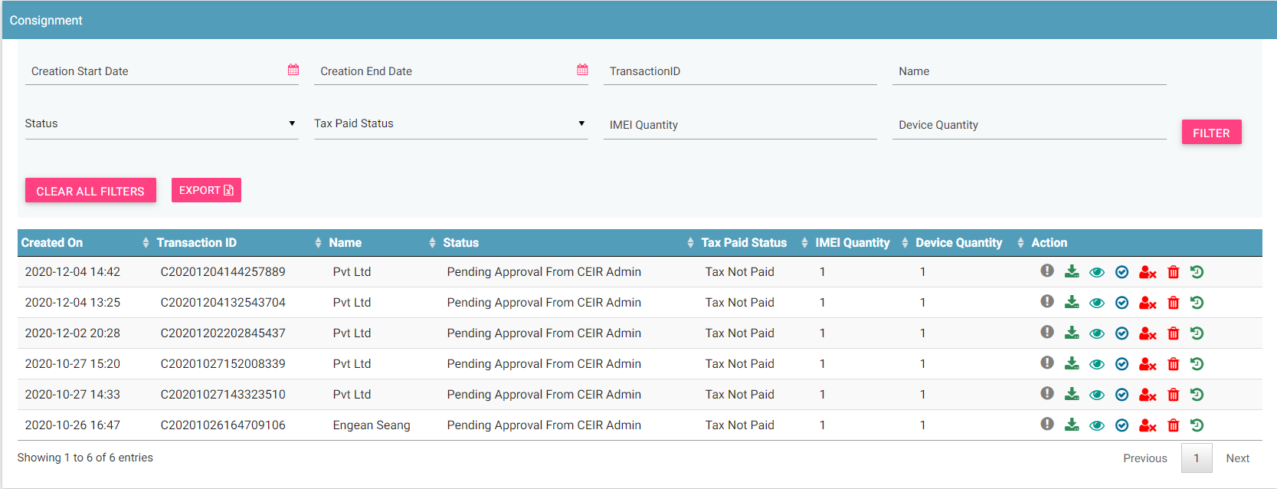
Consignment - View

Slide 10
Stock
Once stock is uploaded by different stakeholders and processed by the system successfully, it is approved/rejected by CEIR Admin
If approved by CEIR Admin, the stock is marked as approved
If rejected by CEIR Admin, then the stock goes back to stakeholder for updation and resubmission
Email Notifications is sent to the stakeholder on approval/rejection by CEIR Admin
Filter can be set on
Start Date/End Date, Transaction ID, Name, Role type, File Name, Status, IMEI Quantity, Device Quantity
All stock details can be exported if required based on filtered value or otherwise.
Clear All Filters can be used to clear filters and refresh the data table.
By default, the data displayed is sorted in descending order on last modified date.
Data can be sorted based on other fields by clicking the arrow buttons on the column headers. On first click, data will be sorted in ascending order. On second click, it will be sorted in descending order.

Slide 11
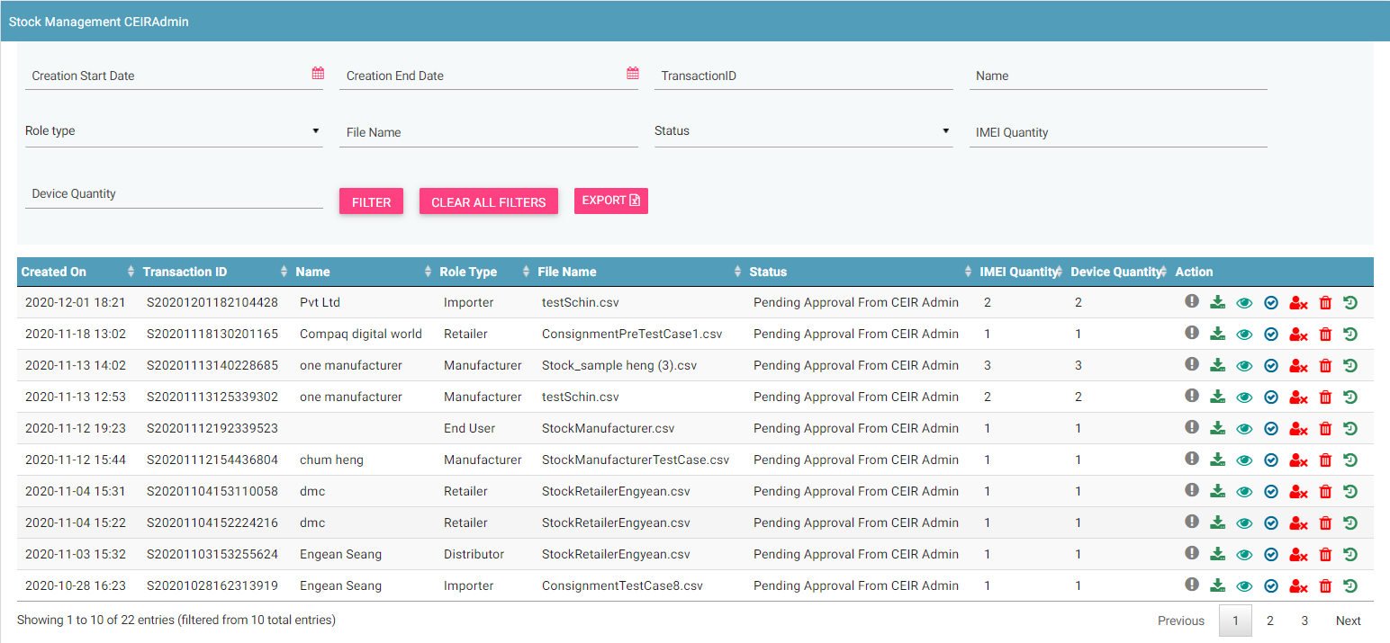
Stock Management - GUI

Slide 12
Registration Request
Once stakeholder is registered and verified the contact details successfully, it is approved / rejected by CEIR Admin
If approved by CEIR Admin, the registration request by user is marked as approved
If rejected by CEIR Admin, then an email is sent to stakeholder. Stakeholder can re-register again in the system.
Email Notifications is sent to the stakeholder on approval/rejection by CEIR Admin
Filter can be set on
Start Date/End Date, User ID, Email, Phone number, Type, User Type, Registration Status
All registration details can be exported if required based on filtered value or otherwise.
Clear All Filters can be used to clear filters and refresh the data table.
By default, the data displayed is sorted in descending order on last modified date.
Data can be sorted based on other fields by clicking the arrow buttons on the column headers. On first click, data will be sorted in ascending order. On second click, it will be sorted in descending order.

Slide 13
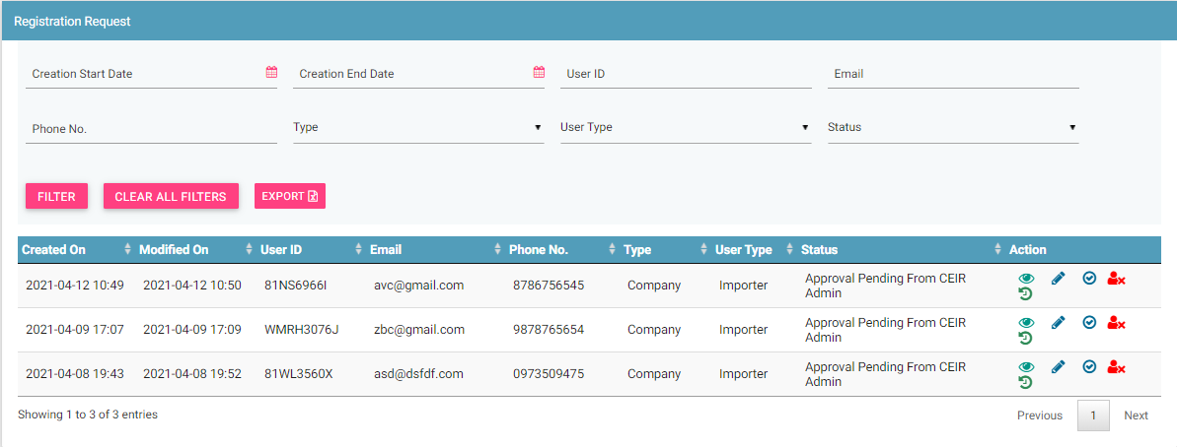
Registration Request - GUI

Slide 14
Block / Unblock Device
Once operator block or unblock one or more device and the same is processed by the system successfully, it is approved/rejected by CEIR Admin
If approved by CEIR Admin, the block/unblock request by user is marked as approved
If rejected by CEIR Admin, then the request goes back to operator for updation and resubmission
Email Notifications is sent to the operator on approval/rejection by CEIR Admin
Filter can be set on
Start Date/End Date, Transaction ID, Operator, Request Type, Mode, Status, IMEI quantity, Device quantity
All request details can be exported if required based on filtered value or otherwise.
Clear All Filters can be used to clear filters and refresh the data table.
By default, the data displayed is sorted in descending order on last modified date.
Data can be sorted based on other fields by clicking the arrow buttons on the column headers. On first click, data will be sorted in ascending order. On second click, it will be sorted in descending order.

Slide 15
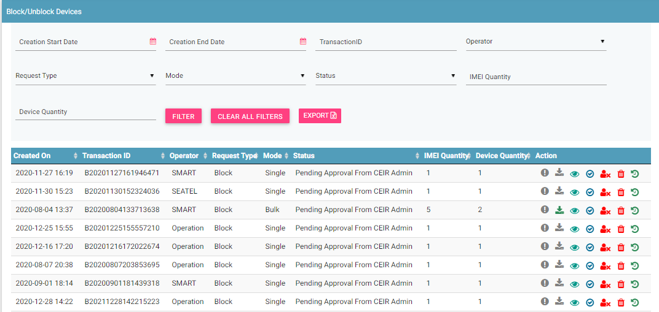
Block/Unblock - GUI

Slide 16
Stolen and Recovery
Once lawful agency mark one or more device as stolen or recovered and the same is processed by the system successfully, it is approved/rejected by CEIR Admin
If approved by CEIR Admin, the stolen/recovery request by user is marked as approved
If rejected by CEIR Admin, then the request goes back to lawful agency for updation and resubmission
Email Notifications is sent to the lawful agency on approval/rejection by CEIR Admin
Filter can be set on
Start Date/End Date, Transaction ID, Block Type, Request Type, Mode, Status, IMEI Quantity, Device Quantity
All request details can be exported if required based on filtered value or otherwise.
Clear All Filters can be used to clear filters and refresh the data table.
By default, the data displayed is sorted in descending order on last modified date.
Data can be sorted based on other fields by clicking the arrow buttons on the column headers. On first click, data will be sorted in ascending order. On second click, it will be sorted in descending order.

Slide 17
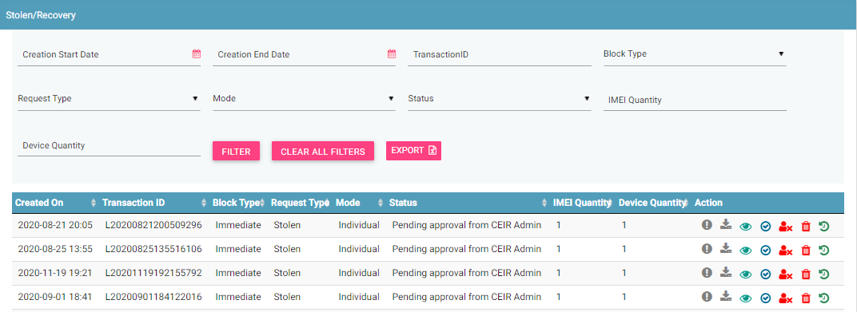
Stolen and Recovery - GUI

Slide 18
Grievance
Once any stakeholder raise a new grievance or reply to curent grievance, the grievance is shared with CEIR admin for further reply or closure
CEIR Admin can either reply and close the grievance OR reply to seek more information
Email Notifications is sent to the stakeholder when CEIR admin reply to grievance.
Filter can be set on
Start Date/End Date, Transaction ID, Grievance ID, User ID, Raised by, User Type, Status
All details can be exported if required based on filtered value or otherwise.
Clear All Filters can be used to clear filters and refresh the data table.
By default, the data displayed is sorted in descending order on last modified date.
Data can be sorted based on other fields by clicking the arrow buttons on the column headers. On first click, data will be sorted in ascending order. On second click, it will be sorted in descending order.

Slide 19
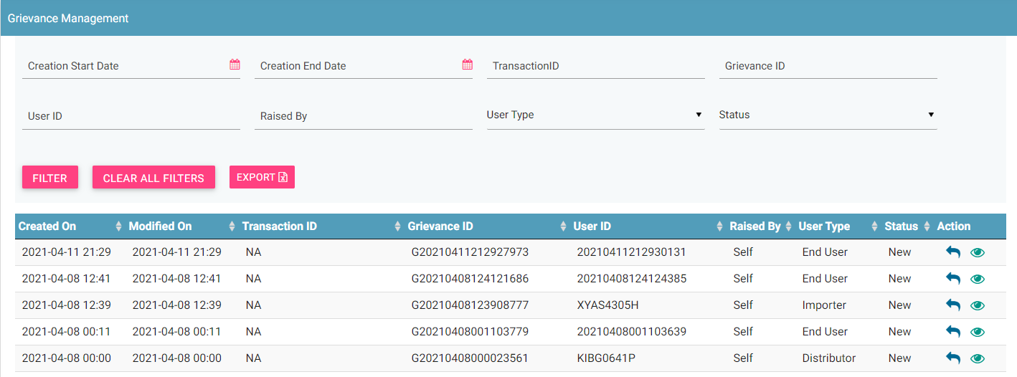
Grievance - GUI

Slide 20
Manage Type Approval
Once importer has recevied approval for TAC OR TRC personnel has approved a TAC request and the
same is processed by the system successfully, it is approved/rejected by CEIR Admin
If approved by CEIR Admin, the Type Approval request by user is marked as approved
If rejected by CEIR Admin, then the request goes back to importer or TRC for updation and resubmission
Email Notifications is sent to the importer/TRC on approval/rejection by CEIR Admin
Filter can be set on
Start Date/End Date, Transaction ID, Display Name, TAC, Brand Name, Model Number, Country, User Type, Status
All request details can be exported if required based on filtered value or otherwise.
Clear All Filters can be used to clear filters and refresh the data table.
By default, the data displayed is sorted in descending order on last modified date.
Data can be sorted based on other fields by clicking the arrow buttons on the column headers. On first click, data will be sorted in ascending order. On second click, it will be sorted in descending order.

Slide 21
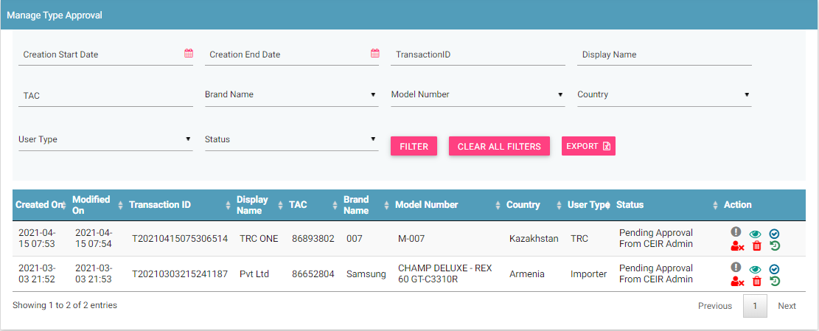
Manage Type Approval - GUI

Slide 22
Register Device
End User Register the device or may or may not pay tax
CEIR Admin to approve/ reject such device registration request.
While viewing the request, the CEIR admin can view
Personal information
Device Information
VIP/ Foreigner / Local
Filter can be set on
Start Date/End Date, NID/Passport No., Transaction ID, Nationality, Tax Paid Status, Origin, Status
All request details can be exported if required based on filtered value or otherwise.
Clear All Filters can be used to clear filters and refresh the data table.
By default, the data displayed is sorted in descending order on last modified date.
Data can be sorted based on other fields by clicking the arrow buttons on the column headers. On first click, data will be sorted in ascending order. On second click, it will be sorted in descending order.

Slide 23
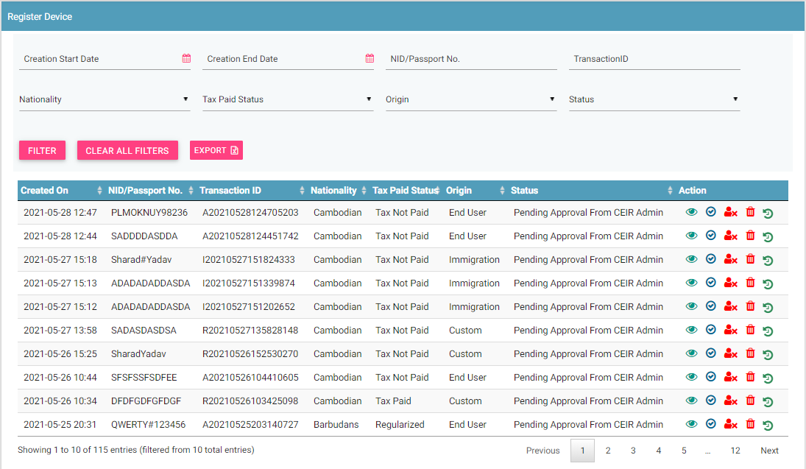
Register Device - GUI

Slide 24
Register Device - GUI

Slide 25
Pending TAC List
Importer registers the consignment containing TAC which are not yet uploaded using the “Manage TAC Approval” functionality by any importer/TRC user
Such consignment are allowed to be uploaded
However a list of such pending TAC per transaction ID is maintained for consignment feature only
When custom approves the consignment, the corrospending entry for that importer is deleted.
In between, if any other importer or TRC user upload the TAC informaiton, that the entry from the list is also deleted.
CEIR admin can view the pending TAC for all consignment.
Filter can be set on
Start Date/End Date, Transaction ID, TAC
All request details can be exported if required based on filtered value or otherwise.
Clear All Filters can be used to clear filters and refresh the data table.
By default, the data displayed is sorted in descending order on last modified date.
Data can be sorted based on other fields by clicking the arrow buttons on the column headers. On first click, data will be sorted in ascending order. On second click, it will be sorted in descending order.

Slide 26
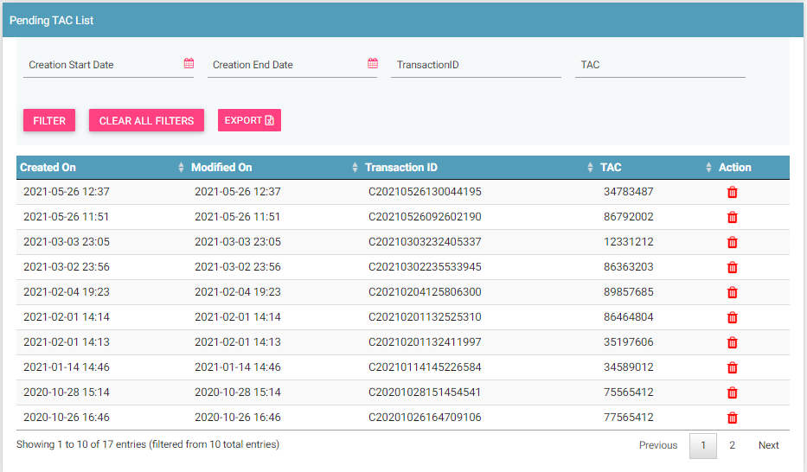
Pending TAC List- GUI

Slide 27
Pending TAC List - GUI
CEIR admin can delete any entry and add remark/reason for deletion

Slide 28
Update VISA
End user wants to update the VISA validity for their devices registered on the CEIR portal.
CEIR admin can view the pending requests for approval.
Filter can be set on
Date filters
Transaction ID
Passport Number
VISA Type
Visa Number
File Number Visa Expiry Date
Status
All request details can be exported if required based on filtered value or otherwise.
Clear All Filters can be used to clear filters and refresh the data table.
By default, the data displayed is sorted in descending order on last modified date.
Data can be sorted based on other fields by clicking the arrow buttons on the column headers. On first click, data will be sorted in ascending order. On second click, it will be sorted in descending order.

Slide 29
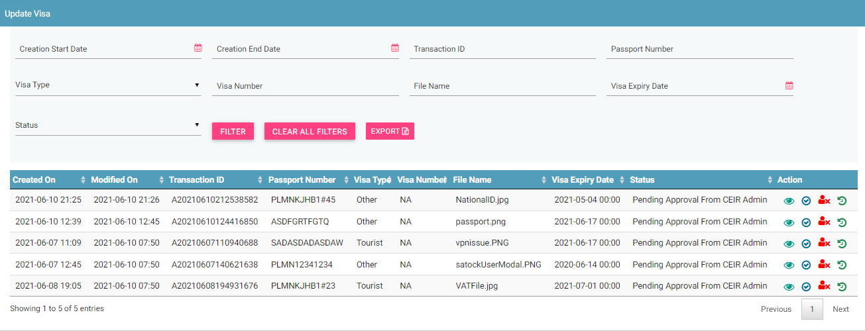
Update VISA - GUI

Slide 30
Queries

Slide 31
Thank You

